Slide 1
Name:- Yash Rajendra Gaikwad
Data Analytics Trainee
Project-7. Analyzing the Impact of Car Features on Price and Profitability.
Software Used:- Microsoft Excel.
Analysis done on following Points:-
Task 1:-How does the popularity of a car model vary across different market categories?
Task 1.A:- Create a pivot table that shows the number of car models in each market category and their corresponding popularity scores.
Task 1.B:Create a combo chart that visualizes the relationship between market category and popularity.
Task 2:- What is the relationship between a car's engine power and its price?
Task:- Create a scatter chart that plots engine power on the x-axis and price on the y-axis. Add a trendline to the chart to visualize the relationship between these variables.
Task 3:-Which car features are most important in determining a car's price?
Task :- Use regression analysis to identify the variables that have the strongest relationship with a car's price. Then create a bar chart that shows the coefficient values for each variable to visualize their relative importance.

Slide 2
Task 4:- How does the average price of a car vary across different manufacturers?
Task 4.A:- Create a pivot table that shows the average price of cars for each manufacturer.
Task 4.B:- Create a bar chart or a horizontal stacked bar chart that visualizes the relationship between manufacturer and average price.
Task 5:- What is the relationship between fuel efficiency and the number of cylinders in a car's engine?
Task 5.A: Create a scatter plot with the number of cylinders on the x-axis and highway MPG on the y-axis. Then create a trendline on the scatter plot to visually estimate the slope of the relationship and assess its significance.
Task 5.B: Calculate the correlation coefficient between the number of cylinders and highway MPG to quantify the strength and direction of the relationship.
Building the Dashboard:-
Task 1:- How does the distribution of car prices vary by brand and body style?
Hints:- Stacked column chart to show the distribution of car prices by brand and body style. Use filters and slicers to make the chart interactive. Calculate the total MSRP for each brand and body style using SUMIF or Pivot Tables.
Task 2:- Which car brands have the highest and lowest average MSRPs, and how does this vary by body style?
Hints:- Clustered column chart to compare the average MSRPs across different car brands and body styles. Calculate the average MSRP for each brand and body style using AVERAGEIF or Pivot Tables.

Slide 3
Task 3:- How do the different feature such as transmission type affect the MSRP, and how does this vary by body style?
Hints:- Scatter plot chart to visualize the relationship between MSRP and transmission type, with different symbols for each body style. Calculate the average MSRP for each combination of transmission type and body style using AVERAGEIFS or Pivot Tables.
Task 4:- How does the fuel efficiency of cars vary across different body styles and model years?
Hints:- Line chart to show the trend of fuel efficiency (MPG) over time for each body style. Calculate the average MPG for each combination of body style and model year using AVERAGEIFS or Pivot Tables.
Task 5:- How does the car's horsepower, MPG, and price vary across different Brands?
Hints:- Bubble chart to visualize the relationship between horsepower, MPG, and price across different car brands. Assign different colors to each brand and label the bubbles with the car model name. Calculate the average horsepower, MPG, and MSRP for each car brand using AVERAGEIFS or Pivot Tables.

Slide 4
Task 1:-How does the popularity of a car model vary across different market categories?
Task 1.A:- Create a pivot table that shows the number of car models in each market category and their corresponding popularity scores.
Task 1.B:- Create a combo chart that visualizes the relationship between market category and popularity.
Process:-
First we use the Pivot table function putting Market Category in Rows and Model & Popularity in values.
also take Count of Model and Average Popularity by using Value field setting.
We also take a slicer for Make i.e Car Company.
We use the column chart of visuliation.
Result:- Crossover,Flex Fuel,Performance; Flex Fuel,Diesel; & Hatchback,Flex Fuel are the most populer market Categarys of cars.
MICROSOFT EXCEL FILE:-https://docs.google.com/spreadsheets/d/1AXEN7ZavvI2flP0aMnhRSenWHz6BH7jO/edit?usp=drive_link&ouid=103974361659264463652&rtpof=true&sd=true
LOOM VIDEO LINK:-https://www.loom.com/share/6f460cabab11478cbf42a6340b2e8500?sid=2441aa93-a136-4031-84d1-41c52808086d

Slide 5
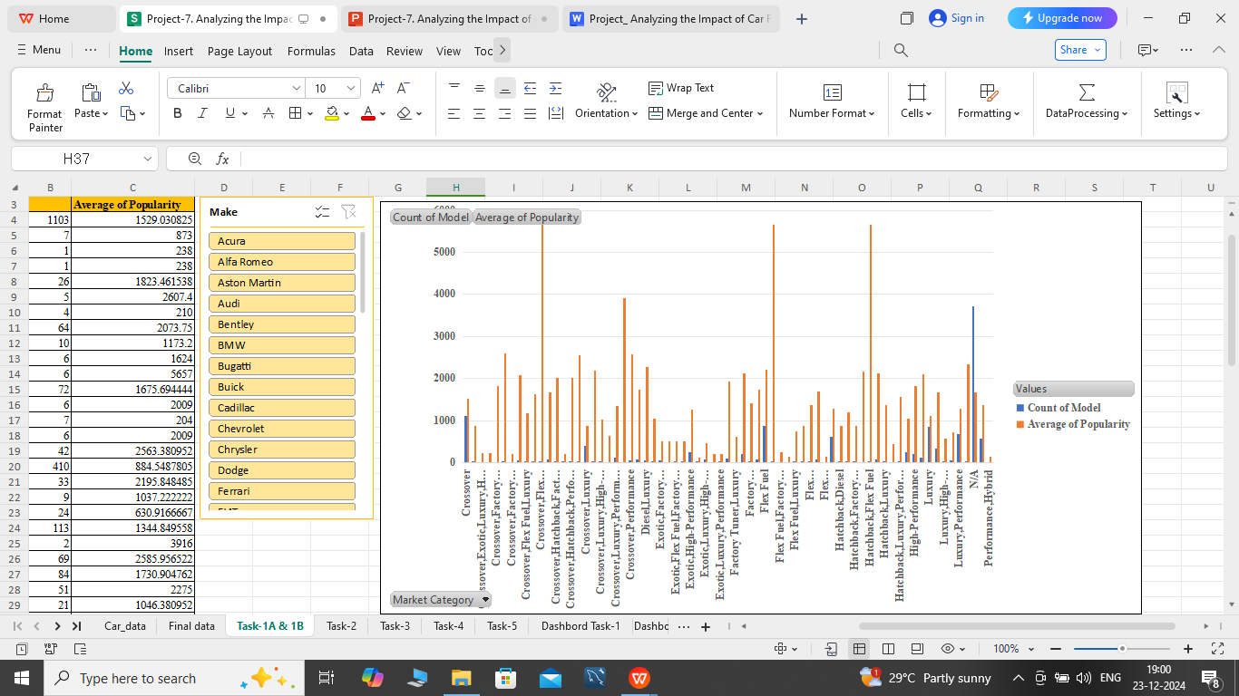

Slide 6
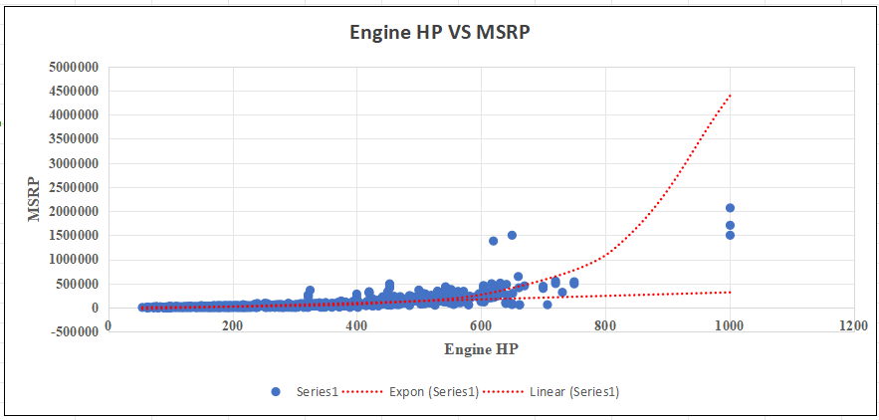
Task 2:- What is the relationship between a car's engine power and its price?
Task:- Create a scatter chart that plots engine power on the x-axis and price on the y-axis. Add a trendline to the chart to visualize the relationship between these variables.
Result:- The Price of car increase with increase in Car Engine Power.

Slide 7
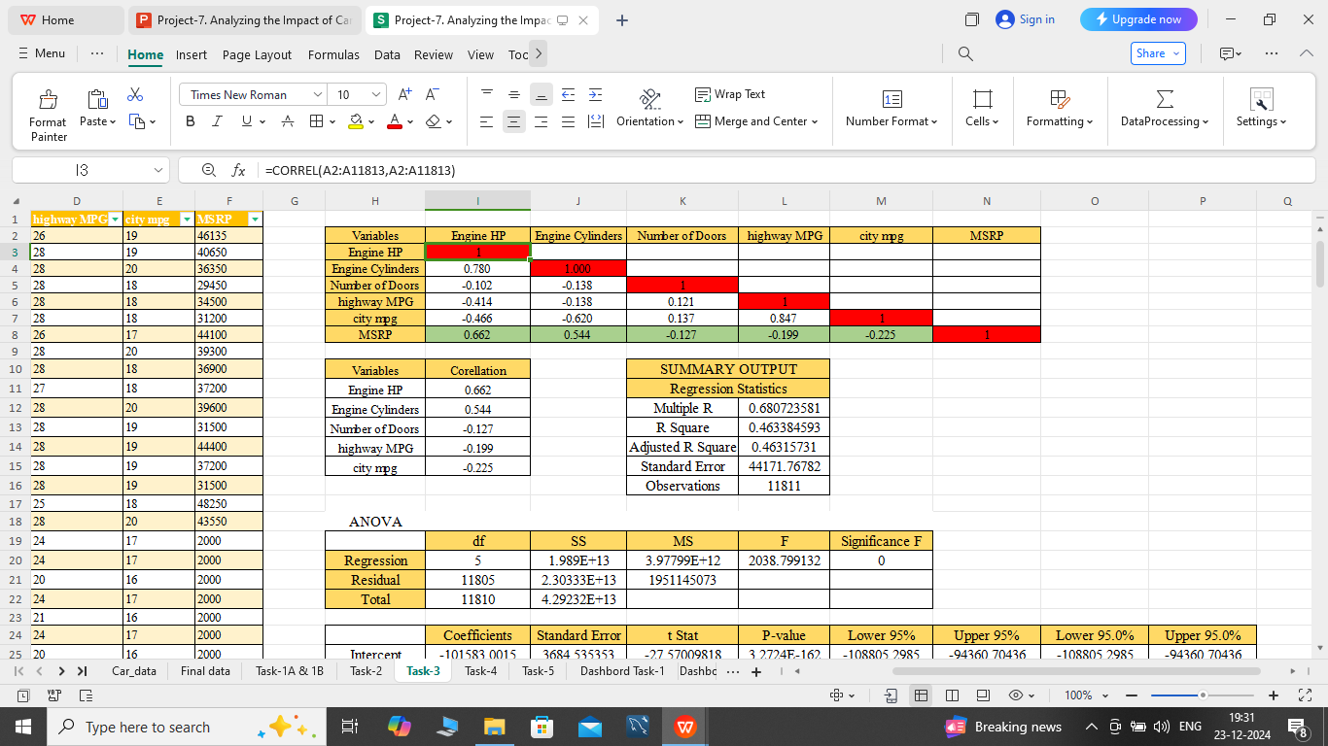
Task 3:-Which car features are most important in determining a car's price?
Task :- Use regression analysis to identify the variables that have the strongest relationship with a car's price. Then create a bar chart that shows the coefficient values for each variable to visualize their relative importance.
Process:-
First we use the CORREL function for finding corelations.
Then, we go to data bar select data analysis and select the Regreassion function.
After that, we get the coefficient values and finally we use Stacked Column chart.

Slide 8
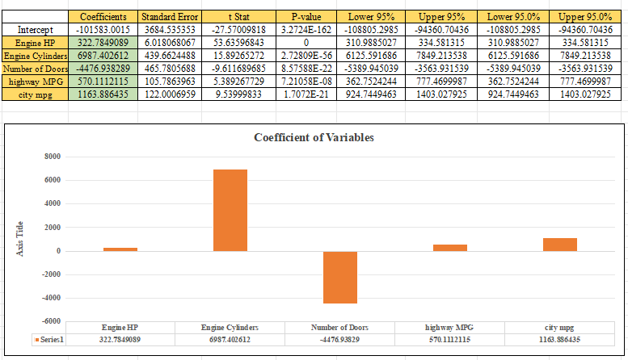
Result:- The car Engine Cylinders and HP is the most important car feature to determine the car price.

Slide 9
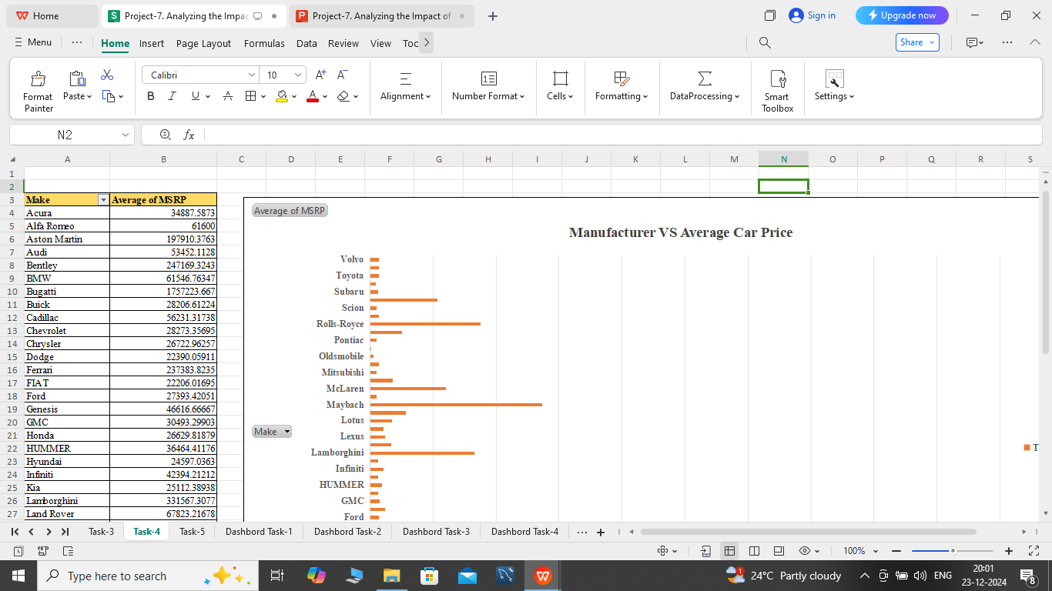
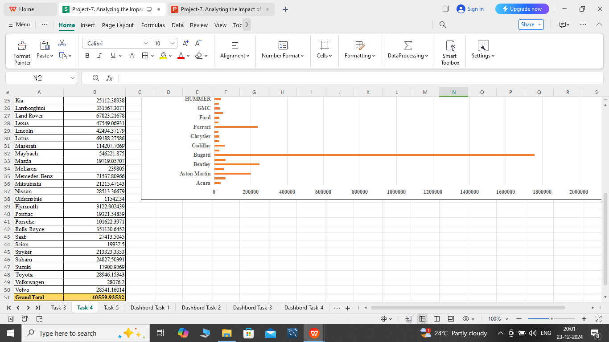
Task 4:- How does the average price of a car vary across different manufacturers?
Task 4.A:- Create a pivot table that shows the average price of cars for each manufacturer.
Task 4.B:- Create a bar chart or a horizontal stacked bar chart that visualizes the relationship between manufacturer and average price.
Process :-
First we use the Pivot table by placing Make column in row and MSRP in Values.
We use Average function for MSRP from the Value field setting.
Lastly we use the Bar chart for representing the Manufacturer and Average Price.

Slide 10
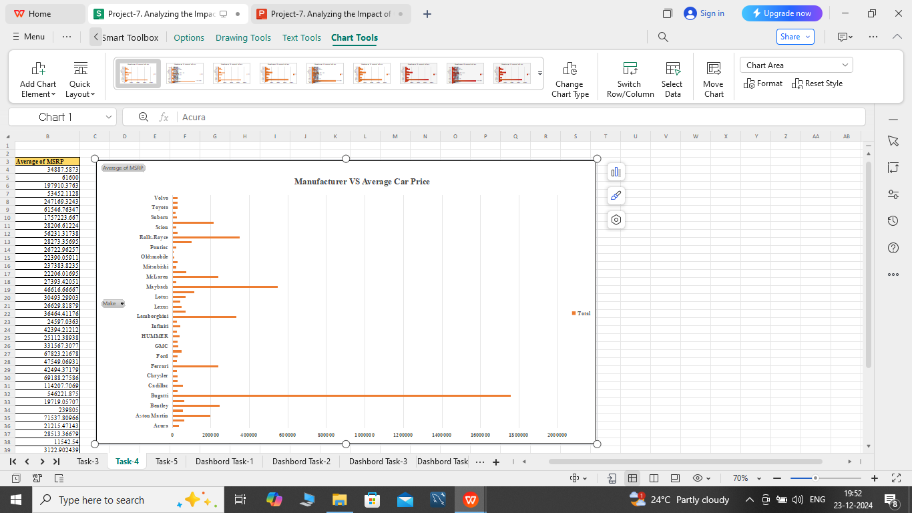
Result:- The Audi car manufacturers have the high Average Car Price.

Slide 11
Task 5:- What is the relationship between fuel efficiency and the number of cylinders in a car's engine?
Task 5.A:- Create a scatter plot with the number of cylinders on the x-axis and highway MPG on the y-axis. Then create a trendline on the scatter plot to visually estimate the slope of the relationship and assess its significance.
Task 5.B:- Calculate the correlation coefficient between the number of cylinders and highway MPG to quantify the strength and direction of the relationship.
Process:-
First we take City MPG and Engine Cylinder column in another sheet.
After that, we use the Correl Function and find the corelatio between City MPG and Engine Cylinder column.
Then, we use the Scatter Plot chart for the visulization.
we also add the trendline.
Result:- If the number of Engine Cylider increased then the Fuel Efficiency will decrease.

Slide 12
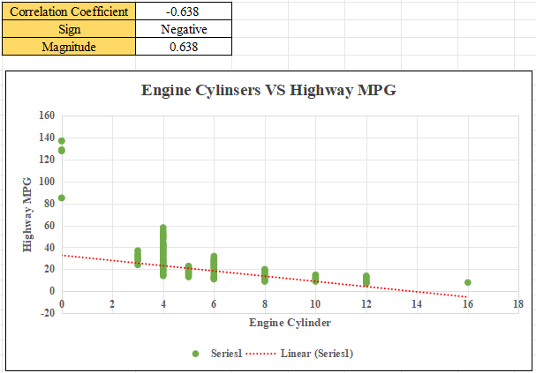

Slide 13
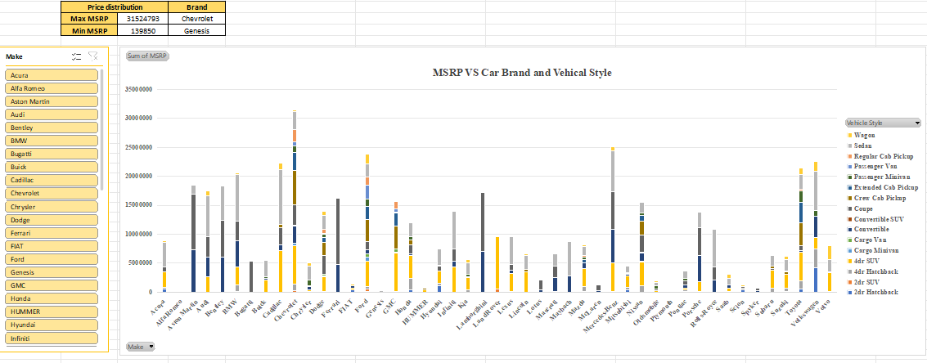
Building the Dashboard:-
Task 1:- How does the distribution of car prices vary by brand and body style?
Hints:- Stacked column chart to show the distribution of car prices by brand and body style. Use filters and slicers to make the chart interactive. Calculate the total MSRP for each brand and body style using SUMIF or Pivot Tables.

Slide 14
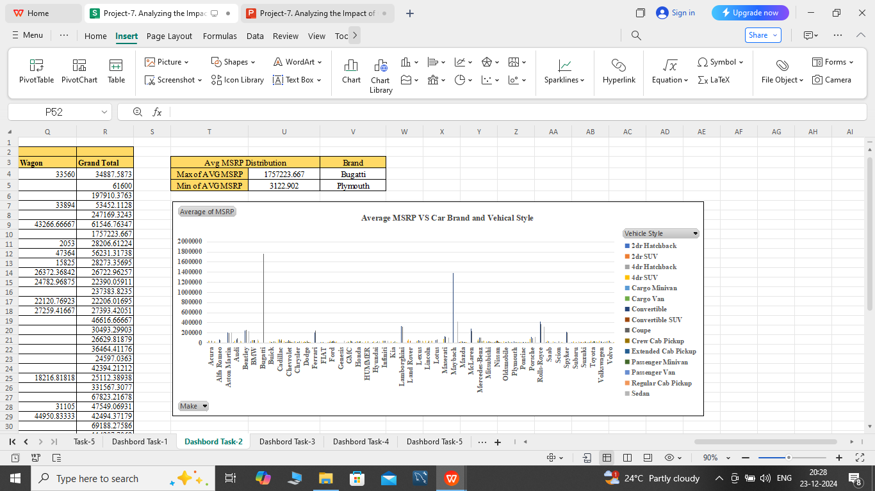
Task 2:- Which car brands have the highest and lowest average MSRPs, and how does this vary by body style?
Hints:- Clustered column chart to compare the average MSRPs across different car brands and body styles. Calculate the average MSRP for each brand and body style using AVERAGEIF or Pivot Tables.

Slide 15
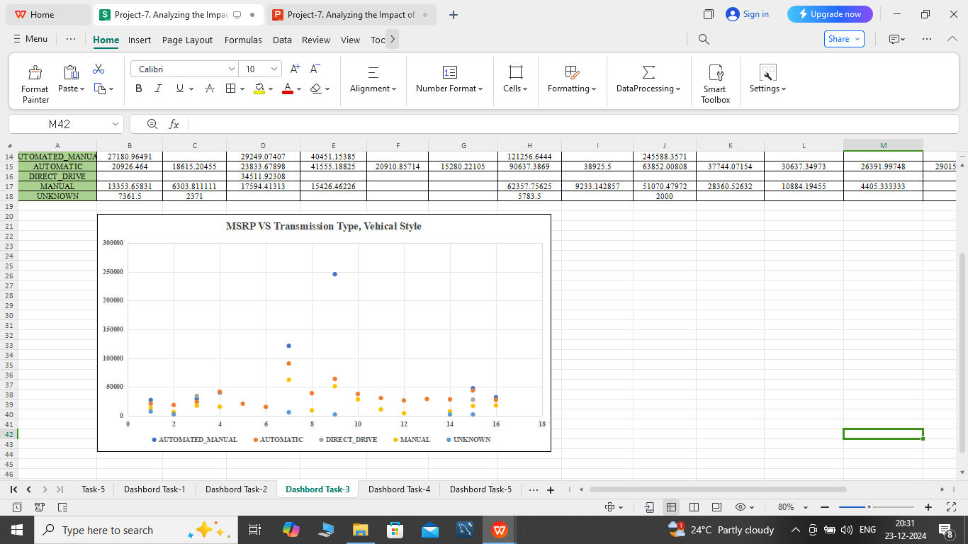
Task 3:- How do the different feature such as transmission type affect the MSRP, and how does this vary by body style?
Hints:- Scatter plot chart to visualize the relationship between MSRP and transmission type, with different symbols for each body style. Calculate the average MSRP for each combination of transmission type and body style using AVERAGEIFS or Pivot Tables.

Slide 16
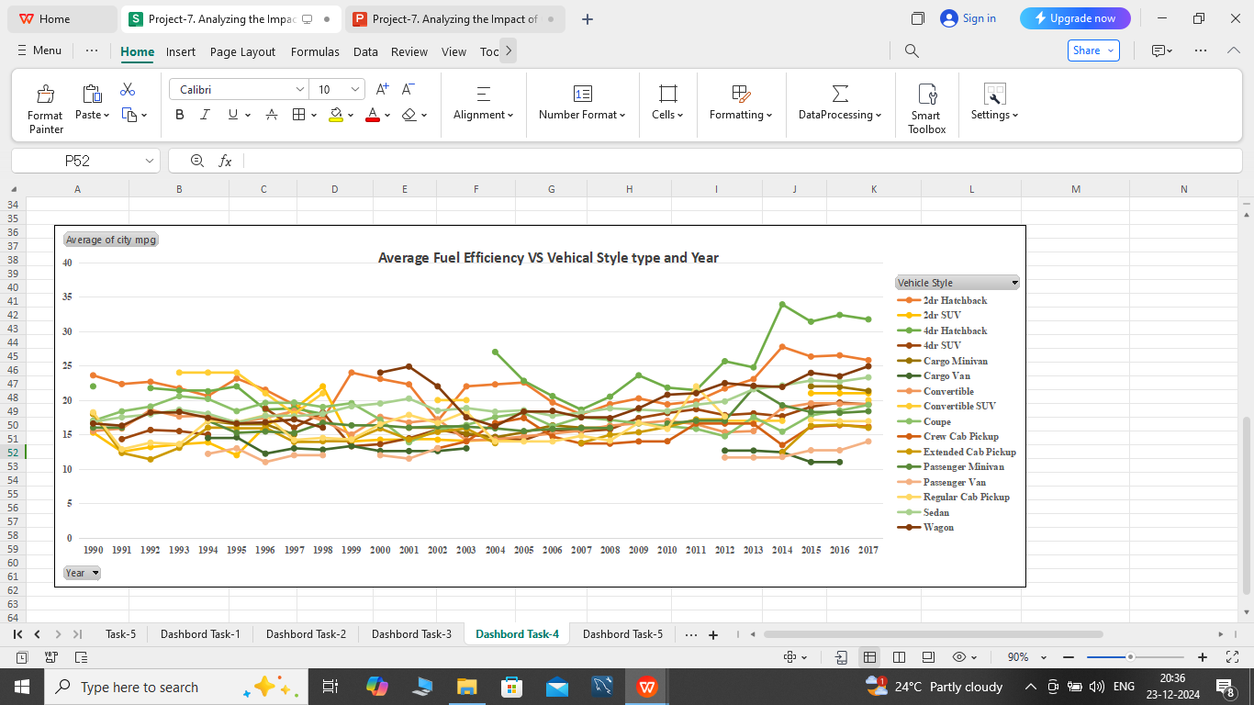
Task 4:- How does the fuel efficiency of cars vary across different body styles and model years?
Hints:- Line chart to show the trend of fuel efficiency (MPG) over time for each body style. Calculate the average MPG for each combination of body style and model year using AVERAGEIFS or Pivot Tables.

Slide 17
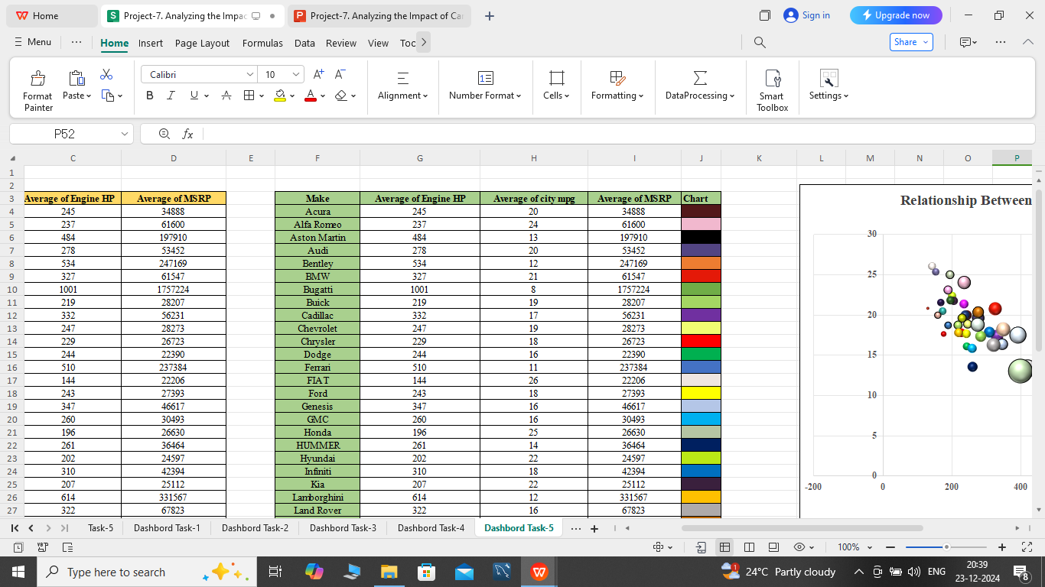
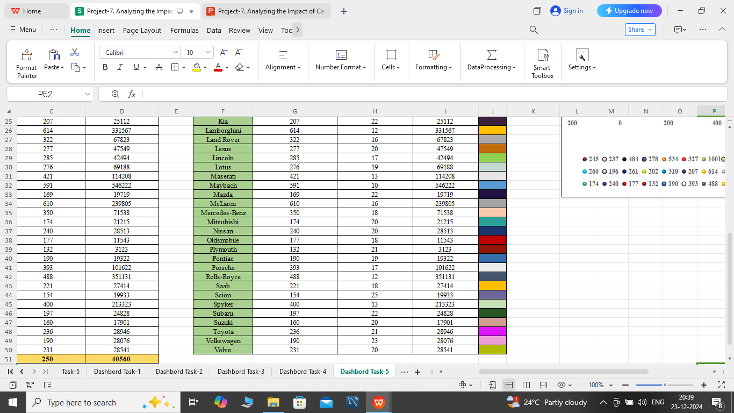
Task 5:- How does the car's horsepower, MPG, and price vary across different Brands?
Hints:- Bubble chart to visualize the relationship between horsepower, MPG, and price across different car brands. Assign different colors to each brand and label the bubbles with the car model name. Calculate the average horsepower, MPG, and MSRP for each car brand using AVERAGEIFS or Pivot Tables.

Slide 18
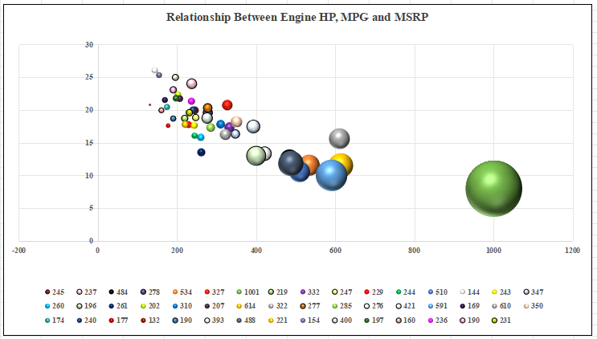

Slide 19
END
MICROSOFT EXCEL FILE:-https://docs.google.com/spreadsheets/d/1AXEN7ZavvI2flP0aMnhRSenWHz6BH7jO/edit?usp=drive_link&ouid=103974361659264463652&rtpof=true&sd=true
LOOM VIDEO LINK:-https://www.loom.com/share/6f460cabab11478cbf42a6340b2e8500?sid=2441aa93-a136-4031-84d1-41c52808086d

